Slide 1
Experiential Learning Phase -I :
Design and Implementation of an SMTP Client-Server Model in C
BY:
KUSHAL R U– 1RV22CS093
MANOJ KUMAR B V– 1RV23CS407
MOHAMMED ADNAN – 1RV23CS409
NAGAPRASAD NAIK– 1RV23CS410

Slide 2
PRESENTATION CONTENTS
1.Problem Statement
2.Objective
3. Methodology
4. Refrences
5.Conclusion

Slide 3
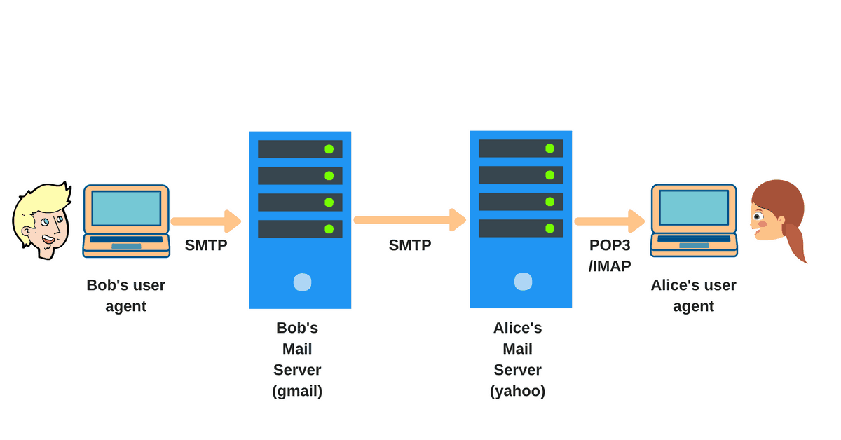
Problem Statement
Developing a C-based SMTP protocol Simulation using socket programming to create a functional client-server model, demonstrating core email communication functionalities.

Slide 4
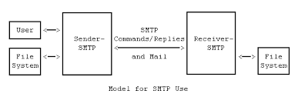
OBJECTIVES
Implement SMTP Protocol
Client-Server Model
Protocol Understanding
Error Handling
Security Measures

Slide 5
METHODOLOGY
Requirement Analysis: Identify the key functionalities of the SMTP protocol and outline the necessary components for implementation in C.
Environment Setup: Configure the development environment with the necessary tools and libraries for C and socket programming.
Socket Programming: Develop the client-server architecture using sockets to enable communication between email clients and the SMTP server.
Protocol Implementation: Code the SMTP commands and responses to handle email transmission, including MAIL, RCPT, DATA, and QUIT commands.
Testing and Debugging: Perform extensive testing to ensure correct functionality and implement error handling mechanisms to address potential issues.
Security Integration: Add basic security features, such as authentication, to enhance the security of email transactions.
Documentation: Document the code, process, and findings to provide a comprehensive overview of the project for future reference.

Slide 6
REFERENCES
D. Lee, J. Kang, M. K. Dahouda, I. Joe, and K. Lee, "DTN-SMTP: A Novel Mail Transfer Protocol with Minimized Interactions for Space Internet," in SpringerLink, 2020. [Online]. Available: https://link.springer.com/chapter/10.1007/978-3-030-50371-0_25.
E. Altulaihan, A. Alismail, M. M. Hafizur Rahman, and A. A. Ibrahim, "Email Security Issues, Tools, and Techniques Used in Investigation," Sustainability, vol. 15, no. 13, p. 10612, Jul. 2023. [Online]. Available: https://doi.org/10.3390/su151310612.
D. B. Abhaya, M. R. Kumar, and S. A. M. K. Ghori, "A Comprehensive Examination of Email Spoofing: Issues and Solutions," International Journal of Computer Science and Network Security, vol. 21, no. 3, pp. 151-158, Mar. 2021. [Online]. Available: https://www.ijcsns.com/2021_21_3/12.pdf.

Slide 7
REFERENCES
4. Donghyuk Lee, Jinyeong Kang, Mwamba Kasongo Dahouda, Inwhee Joe, Kyungrak Lee, "DTN-SMTP: A Novel Mail Transfer Protocol with Minimized Interactions for Space Internet," in Gervasi O., Murgante B., Misra S., et al. (eds) Computational Science and Its Applications – ICCSA 2020. ICCSA 2020. Lecture Notes in Computer Science, vol 12253. Springer, Cham, 2020. doi: 10.1007/978-3-030-58808-3_45.
5. M.T. Banday, J.A. Qadri, S.A. Sheikh, "Secure E-mail Communications Through Cryptographic Techniques—A Study," Springer Nature Singapore Pte Ltd., 2021. doi: 10.1007/978-981-15-8767-2_23.

Slide 8
CONCLUSION
Socket Programming: Utilizing the Berkeley sockets API for establishing network connections and handling data transmission.
Protocol Compliance: Ensuring adherence to the SMTP standards defined in RFC 5321, governing email transfer across networks.
Error Handling: Implementing robust error handling mechanisms to manage various scenarios, such as network failures or protocol violations.
Code Organization: Structuring the codebase to maintain clarity and modularity, essential for scalability and future maintenance.
Educational and Practical Value: Provides a valuable resource for learning network programming, protocol implementation in C, and understanding the intricacies of email communication protocols.
Modularity and Code Organization: Structured for clarity and modularity, facilitating ease of maintenance and scalability for future enhancements or customization.

